Slide 1


Research To Reality Mentorship Pilot Program Close-Out Meeting
March 6-7th, 2013 National Cancer Institute, Bethesda, MD

Slide 2
Meeting Agenda
DAY 1: March 6, 2013
Welcome and Introductions Peyton Purcell | 1:00-1:30pm
Mentee-Mentor Presentations | 1:30-4:00pm
PCD Case Studies: Discussion and Writing Time Mike Sanchez | 4:00-5:30pm
Group Dinner – Chef Geoff’s | 6:00-8:00pm
DAY 2: March 7, 2013
Light Breakfast (optional) | 8:00
Research Translation Implications Russ Glasgow | 8:30-10:00am
Online Communities of Practice: Connecting Research & Practice Cindy Vinson | 10:15-11:15am
Presentation of Certificates Bob Croyle/Lenora Johnson | 11:15-11:30
Networking and Lunch | 11:30-12:30
Tour of Clinical Center (optional) | 1:00-2:30
2

Slide 3
Modified Meeting Agenda – due to inclement weather
DAY 1: March 6, 2013
PCD Case Studies: Discussion and Writing Time | Any time – on your own
DAY 2: March 7, 2013
Light Breakfast (optional) | 8:00
Research Translation Implications Russ Glasgow | 8:30-9:30am
Mentee Presentations Michael Celestin Lisa Troyer Angela McFall Charlene Mitchell Venice Haynes Kiameesha Evans | 9:30-11:30
Presentation of Certificates Bob Croyle/Lenora Johnson | 11:30-11:45
Working Lunch: Online Communities of Practice: Connecting Research & Practice Cindy Vinson | 11:45-12:30pm
Tour of Clinical Center (optional) | 1:00-2:30
3

Slide 4

R2R Pilot Mentorship Pilot Program: Development – 2010 & 2011
EVIDENCE
2010
The idea of the mentorship program is born
Literature reviews conducted
External planning group assembled
Key informant interviews completed
CAPACITY BUILDING
COMMUNITY
Purcell et al, Research to Reality (R2R): Building Community, Capacity, and Evidence. Health Promotion Practice. 2013 [ePub]
Notes:
Another training opportunity that is offered through the R2R Mentorship Pilot program – Begun in September 2011,
six mentees, with guidance from their mentor and technical assistance & training from NCI, and engagement with the R2R community of practice, work on a year-long cancer control and prevention project relevant to their current jobs to learn and apply the skills and knowledge of evidence-based public health (EBPH). The competencies include… and here is the breakdown of how many are focusing on which

Slide 5
R2R Pilot Mentorship Pilot Program: Development – 2010 & 2011
Purcell et al, Research to Reality (R2R): Building Community, Capacity, and Evidence. Health Promotion Practice. 2013 [ePub]
Notes:
Another training opportunity that is offered through the R2R Mentorship Pilot program – Begun in September 2011,
six mentees, with guidance from their mentor and technical assistance & training from NCI, and engagement with the R2R community of practice, work on a year-long cancer control and prevention project relevant to their current jobs to learn and apply the skills and knowledge of evidence-based public health (EBPH). The competencies include… and here is the breakdown of how many are focusing on which

Slide 6
R2R Pilot Mentorship Pilot Program: Development – 2010 & 2011
2010
The idea of the mentorship program is born
Literature reviews conducted
External planning group assembled
Key informant interviews completed
2011
Applications opened (May)
Six mentees selected and paired with mentors (July)
Kick-off Meeting held in Bethesda (September)
EVIDENCE
CAPACITY BUILDING
COMMUNITY
Notes:
Another training opportunity that is offered through the R2R Mentorship Pilot program – Begun in September 2011,
six mentees, with guidance from their mentor and technical assistance & training from NCI, and engagement with the R2R community of practice, work on a year-long cancer control and prevention project relevant to their current jobs to learn and apply the skills and knowledge of evidence-based public health (EBPH). The competencies include… and here is the breakdown of how many are focusing on which

Slide 7
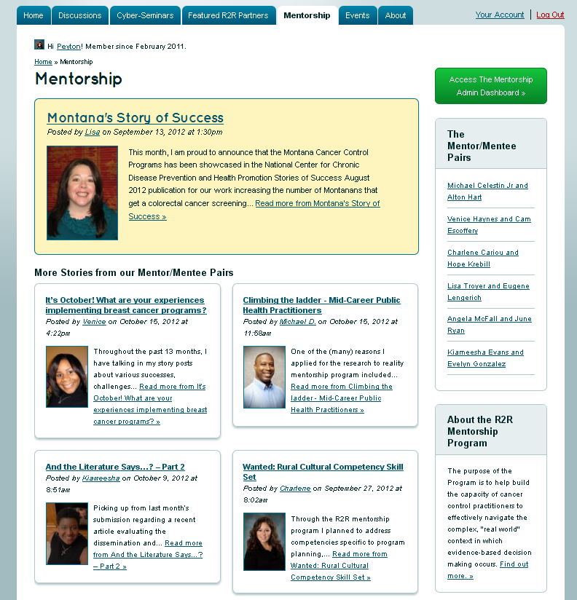
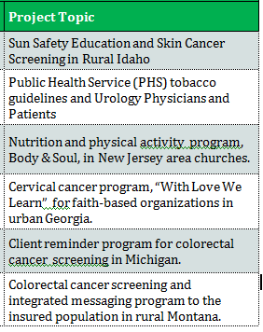
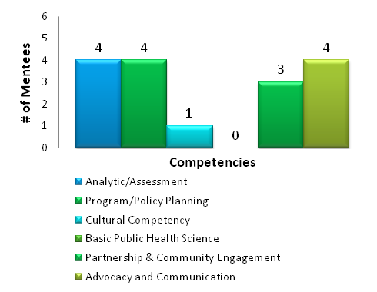
R2R Pilot Mentorship Pilot Program: Implementation - 2012
http://researchtoreality.cancer.gov/mentorship
Notes:
They share their experiences with the broader R2R community through monthly stories…
The R2R workspace will continue to be available to you for the next several months at least – a note will be sent prior to any changes in access so you can download any necessary materials you want to keep for your own files.

Slide 8

The R2R Mentorship Pilot Program: Measuring Success - 2013
Evaluation - Westat Contractor
Quarterly reports and training/Meeting evaluations surveys (ongoing)
Post-program competency assessment (February)
Participant interviews with mentees and mentors (March)
Interviews with mentees’ supervisors (March)
Program team interviews (April)
Content analysis of R2R content and deliverables (March-April)
Web Analytics

Slide 9
The R2R Mentorship Pilot Program: Dissemination
Convening external planning group to review evaluation report and discuss next steps
Health Promotion Practice manuscript (2013)
Preventing Chronic Disease article series
6 case studies by mentees/mentors
Additional articles on:
Pilot Program Evaluation (Sanchez/Purcell)
Review of Online Communities of Practice (Vinson)
Case example of R2R Community of Practice (La Porta/Gallagher/Farrell)
Presentations by NCI Staff and (hopefully) Mentees/Mentors

Slide 10
Preventing Chronic Disease: Case Studies
March 6th, 2013
R2R Mentorship Close-Out Meeting
Bethesda, MD
Michael Sanchez, MPH, CHES Implementation Science, DCCPS, NCI

Slide 11
Purpose
To explore the application of two models and their intersection (communities of practice and mentorship) as strategies to foster the translation of cancer control and prevention research into effective practice.
11

Slide 12
PCD Series: Content
The Promise of VCoP to Translate Research into Practice (Vinson)
R2R: An Online Community of Practice (LaPorta)
A Mentorship Approach to Building Cancer Control Capacity (Sanchez)
Adaptation of Cervical Ca Prevention Program for African American Couples in the Faith-based Community (Haynes)
Health Care Providers and Insurance Companies Partner to Implement Client-reminders for Colorectal Ca Screening (Troyer)
12

Slide 13
PCD Series: Content
Adapting and Implementing Pool Cool in Rural Idaho (Mitchell)
Implementing a Colorectal Ca Screening Client-reminder Intervention in a Health Insurance Worksite (McFall)
Body &Soul: From Recruitment to Scale-up and Beyond (Evans)
Partnering with Health Care Systems to Assess Tobacco Use and Treatment Practices among Clinicians (Celestin)
Editorial Essay (Brownson)
13

Slide 14
PCD Case Study: Required Format
Background
Community Context
Methods
Outcome
Interpretation
14

Slide 15
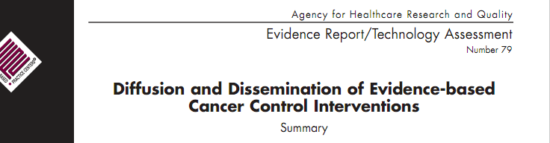
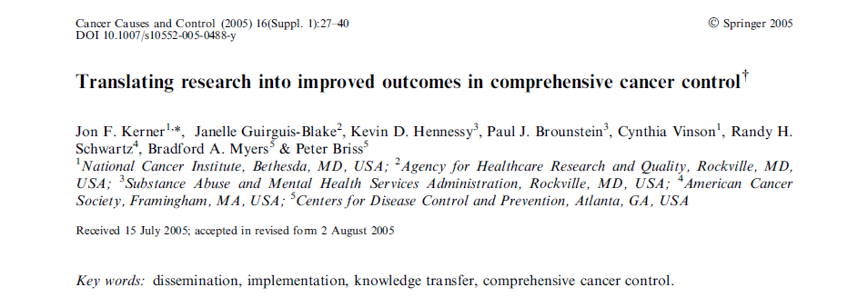
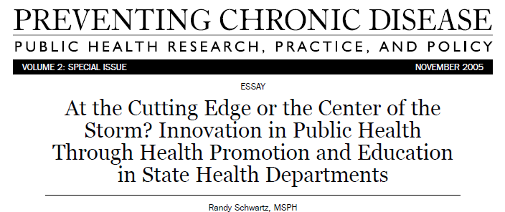
What Does It Take To Move Research Into Practice?
Notes:
And so, what we’re seeing more and more in the literature is this question:
What does it really take to move our best evidence-based research into every day practice?

Slide 16
Timeline
Date | Task | Responsibility
March 6, 2013 | Enlist primary authors | Sanchez
March 15, 2013 | Contact relevant co-authors. Invitation to expand paper for peer-review. Identify 3 guest editors. | Sanchez, La Porta, Vinson, Celestin, Haynes, Cariou, Troyer, McFall, Evans
June 6, 2013 | Initial draft due. All authors will have the chance to review other papers during this time | Sanchez, La Porta, Vinson, Celestin, Haynes, Cariou, Troyer, McFall, Evans
June 20, 2013 | Call with all authors | All Authors
July 5, 2013 | Revised draft due for Editorial essay author | Sanchez, La Porta, Vinson, Celestin, Haynes, Cariou, Troyer, McFall, Evans
July 22, 2013 | Editorial essay | Brownson
July 29, 2013 | Initial submission | All Authors
October 28, 2013 | Reviews completed | PCD Editors
November 18, 2013 | Resubmission due | All Authors
December 13, 2013 | Reviews completed | PCD Editors
TBD | Manuscript series published | PCD Editors
16

Slide 17

Questions?
Notes:
So that’s about all I have for today.
I do encourage you to take a closer look at Cancer Control PLANET.
I’ve talked way too much, and would like to hear from you.
I think we have some time for Q&A.
17

Slide 18
Bridging Research and Practice: Implications and Next Steps
March 7th, 2013
R2R Mentorship Close-Out Meeting
Bethesda, MD
Russell Glasgow, PhD Deputy Director, Implementation Science, DCCPS, NCI

Slide 19
Session Agenda
Background:
NCI Implementation Science (IS) Team
Key IS Issues
IS Models (and practical relevance):
Evidence Integration Triangle
Key Lessons Learned
RE-AIM model applications
IS Methods:
Types of Evidence Needed
RE-AIM Framework
Pragmatic Example: The MOHR Project
General Discussion/Q&A
Coming Up Next…
19

Slide 20
NCI Implementation Science Team Vision
To achieve the rapid integration of scientific evidence, practice, and policy, with the ultimate goal of improving the impact of research on cancer outcomes and promoting health across individual, organizational and community levels.
http://cancercontrol.cancer.gov/IS/
20

Slide 21
Implementation Science Team Mission and Priorities
BUILD: Build the Field of Implementation Science (IS) Stimulate an increasing number of competitive grant submissions on cancer implementation science that contribute to the development of innovative methods and study designs. Build science to Integrate new knowledge across clinical and public health research, practice and policy. Promote science that is rigorous, transparent and relevant in the real world. Foster rapid learning strategies to improve individual and population health.
PARTNER: Establish Robust Partnerships Build partnerships for the development, dissemination, and implementation of evidence-based measures, initiatives, and programs.
TRAIN: Develop Ongoing Training Networks Develop a robust and supportive network of trained, trans-disciplinary implementation scientists.
21
Notes:
The R2R mentorship program, a collaboration with the NCI Office of Communications and Education, really fits into all three of these categories as a partnership, a training opportunity, and, an opportunity to build the field through a great understanding of the translation issues, opportunities, and role of context in implementation.

Slide 22
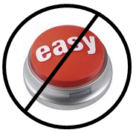
Key Issues in Implementation Science (IS)
Contextual
Complex
Multi-component programs and policies
Non-linear
Transdisciplinary
Multi-level
Addresses ‘wicked’, messy, important problems
Glasgow R & Steiner J. (2012). In Dissemination and Implementation Research. Browson, R, Colditz, G, and Proctor, E (Eds.). Oxford University Press
22

Slide 23
Evidence: An abundance on internal validity; An dearth on contextual factors
Fidelity/adaptation/fit issues
Role of practice-based evidence/evidence-informed practice (ala Larry Green)
Reporting study results- so transparent and useful
……..
Your experience and recommendations- need your help ☺
23
Notes:
This is really what the mentorship program, the participants, their projects can help us learn and some of what we hope to discuss today.

Slide 24
Implementation Science Models/Methods

Slide 25
A Proliferation of ‘IS’ Models 61 at Least, but there are Key Common Points
Context is critical
Begin with stakeholders—take their perspective
Design for dissemination—from beginning—cannot wait until the end
Need balance between fidelity to evidence-based program and adaptation to local setting
Tabak RG, Khoong EC, Chambers DA, Brownson RC. Bridging research and practice: models for dissemination and implementation research. Am J Prev Med. 2012 Sep; 43(3):337-50.
25

Slide 26
Key Common Points (cont.)
There is more than evidence needed for successful adoption, implementation and sustainability
Implementation Science is a multi-level affair
Select the DESIGN and the MODEL that best fits your question—less important WHICH model than that you use it well
Need to focus on replication, relevance, transparency, and costs
26

Slide 27
Evidence Integration Triangle (EIT)
Intervention Program/Policy (Prevention or Treatment)
(e.g., key components; principles; guidebook; internal & external validity)
Feedback
Feedback
Evidence
Stakeholders
Participatory Implementation Process
(e.g., stakeholder engagement; CBPR; team-based science; patient centered)
Practical Progress Measures
(e.g., actionable & longitudinal measures)
Feedback
Multi-Level Context
Intrapersonal/Biological | Policy
Interpersonal/Family | Community/Economic
Organizational | Social/Environment/History
Glasgow RE, Green LW, Taylor MV, Stange KC. AJ Prev Med 2012;42(6):646-654
27

Slide 28
Evidence Integration Triangle (EIT) - A Patient-Centered Care Example
Intervention Program/Policy Evidence-based decision aids to provide feedback to both patients and health care teams for action planning and health behavior counseling
Evidence:
US Preventive Services Task Force recommendations for health behavior change counseling; goal setting & shared decision making
Feedback
Feedback
Stakeholders:
Primary care (PC) staff, patients and consumer
groups; health care system decision makers; groups involved in meaningful use of EHRs
Participatory Implementation Process
Iterative, wiki activities to engage stakeholder community, measurement experts and diverse perspectives
Practical Progress Measures
Brief, standard patient reported data items on health behaviors & psychosocial issues -- actionable and administered longitudinally to assess progress
Feedback
Multi-Level Context
Dramatic increase in use of EHR | CMS funding for annual wellness exams
Primary Care Medical Home | Meaningful use of EHR requirements
28

Slide 29
EIT Conclusions
The evidence-based movement is a good start, but only gets us so far
To make greater progress, two other elements also need attention:
Practical MEASURES to track progress, and
Implementation PROCESSES that use partnership principles
These 3 legs of the “EIT” are each necessary but not sufficient by themselves
http://cancerconrol-dev.cancer.gov/IS/presentations
29

Slide 30
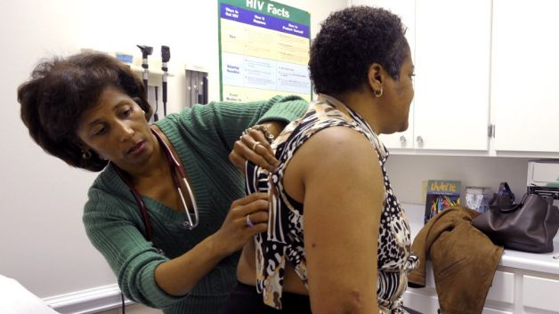




RE-AIM—Health Equity Implications
RE-AIM Issue | Disparity | Overall Impact
Reach | 30% | 70% of benefit
Effectiveness | 0 (equal) | 70% of benefit
Adoption | 30% | 49% of benefit
Implementation | 30% | 34% of benefit
Maintenance | 30% | 24% of benefit
http://cancercontrol.cancer.gov/IS/presentations.html

Slide 31
RE-AIM Realist* Question
What percent and types of patients are Reached;
For whom among them is the intervention Effective; in improving what outcomes; with what unanticipated consequences;
In what percent and types of settings and staff is this approach Adopted;
How consistently are different parts of it Implemented at what cost to different parties;
And how well are the intervention components and their effects Maintained?
*Pawson R, et al. J Health Serv Res Policy 2005;10(S1):S21-S39.
Gaglio B, Glasgow RE. Evaluation approaches…In: Brownson R, Colditz G, Proctor E, (Eds). Dissemination and implementation research in health: Translating science to practice. New York: Oxford University Press; 2012. Pages 327-356.
31

Slide 32
RE-AIM Evaluability Questions or Planning for Dissemination
What percent and what types of patients are likely to Receive this program;
For whom among them is the intervention Effective; in improving what outcomes; what broader effects and potential negative consequences?
What percent and what types of settings and practitioners are likely to Adopt this program;
How consistently are different parts of the program likely to be Implemented across settings, clinicians, and patient subgroups, ……. and at what cost;
And how well is the eHealth program and its effects likely to be Maintained?
YOUR ideas and input needed here ☺
Leviton LC, et al. Evaluability assessment…Annu Rev Public Health 2010;31:213-233.
32

Slide 33
Implementation Science Measures/Methods

Slide 34
Types of Pragmatic Methods and Evidence Needed: 2R’s and “RCT”
Relevant
Rigorous and
Rapid
Cost informative
Transparent
Glasgow R, Annals of Behavioral Medicine, 2008, 35: 19-25.
Glasgow R, Chambers D. Clinical and Translational Science, 2012, 5(1):48-55
http://cancercontrol.cancer.gov/IS/
34

Slide 35
Pragmatic Measures
Required Criteria
Important to stakeholders
Burden is low to moderate
Broadly applicable, has norms to interpret
Sensitive to change
Additional Criteria
Actionable
Low probability of harm
Addresses public health goal(s)
Related to theory or model
“Maps” to “gold standard” metric or measure
Glasgow, R. E. & Riley, W. T. Pragmatic measures… Am J Prev Med (in press).
35

Slide 36
Pragmatic Study Methods: Key Characteristics
Questions from and important to stakeholders
Multiple, heterogeneous settings
Diverse populations
Comparison conditions are real-world alternatives
Multiple outcomes important to decision and policy makers
Thorpe KE et al., Can Med Assoc J, 2009;180:E47-57
Tunis SR et al. Practical clinical trials…JAMA 2003;290:1624-1632
Glasgow RE et al. Practical clinical trials…Med Care 2005;43(6):551-557
36

Slide 37
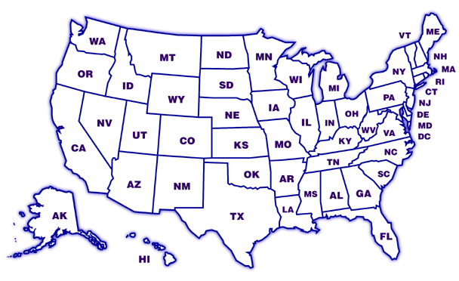
MOHR Project- Key Points
Cluster randomized trial of 9 pairs of clinics. Approximately half of clinics community health centers; others AHRQ type PBRN clinics
Designing for flexibility and adoption—e.g., varying levels of clinic integration of EHRs, different levels and modalities of decision aids
WHAT is delivered—e.g., Automated assessment tool, feedback, goal setting materials, follow-up are STANDARD;
HOW this is delivered is customized to setting
Study goal = Sustainable, routine use of intervention
OR
VT
CA
VA
NC
TX
www.MyOwnHealthReport.org
37
Notes:
3/5/2013
National Cancer Institute
37

Slide 38
Rapid Learning Approaches
Data Collected:
With real (and complex) patients
By real-world staff
Under real-world conditions and settings
And evaluated through real-time data (often with Electronic Health Records)
Tunis,S.R.; Carino,T.V.; Williams,R.D.; Bach,P.B. A Rapid Learning Health System. Health Affairs (supplement). 2007;26(2):140-149.
38

Slide 39
All Models (and Methods) are Wrong…
….Some are useful
“To every complex question,
there is a simple answer…
and it is wrong.”
H. L. Mencken
39

Slide 40
Future Directions and Opportunities

Slide 41
Future Evidence Needs and Opportunities—Keys to Advance Translation
Context—key factors that may moderate results
Scalability—potential to impact large numbers
Sustainability
Health equity impacts
Patient/citizen/consumer and community perspective and engagement throughout
Multi-level interactions, especially between policy and practice
Practice Based Evidence- and how to evaluate it
41

Slide 42
Future Evidence Needs and Opportunities—Keys to Advance Translation Continued
Critical evaluation of training programs or resources that address these issues (e.g. TACTICC, CPCRN 2-1-1, lessons learned from EBM and nursing mentorship process, PBRNs, etc.)
Partnership/Collaboration to implement approaches such as the Chronic Care model, the EIT, or the Health Literate Care Model
Existing NIH mechanisms could help to build the science in this area
Partnerships with existing delivery infrastructures
Taking training/mentoring programs to scale-and how to sustain them
Your input needed…
42

Slide 43
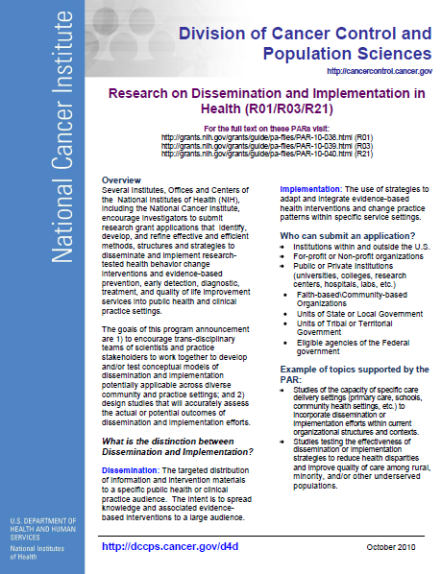
The Trans-NIH D&I Funding Announcement
R01 - PAR 13-055 ($500k per annum up to five years) R03 - PAR 13-056 ($50K per annum up to two years) R21 - PAR 13-054 ($275K up to two years)
Participating Institutes: NIMH, NCI, NIDA, NIAAA, NIAID, NHLBI, NINR, NIDDK, NINDS, NIDCD, NIDCR, NCCAM, NHGRI*, NIA* & Office of Behavioral & Social Sciences Research
Standing review committee, Dissemination and Implementation Health Research
Three submission dates per year: February, June, October
* New Institute Added to PAR in 2013
http://cancercontrol.cancer.gov/funding_apply.html#is
43

Slide 44

Take Home Points
There is a pressing need for a DIFFERENT type of research, models and methods — “IS” that translates more rapidly, and is more relevant to stakeholders
An equally pressing need for training and collaborative partnership learning opportunities
We, the field, the NCI , the health care system and your country NEED your continued engagement and feedback, creative ideas
Thank You!
44

Slide 45

Questions and Discussions
Contact me: glasgowre@mail.nih.gov
IS Team Website: http://dccps.cancer.gov/is/
IS Team Email: NCIdccpsISteam@mail.nih.gov
45

Slide 46
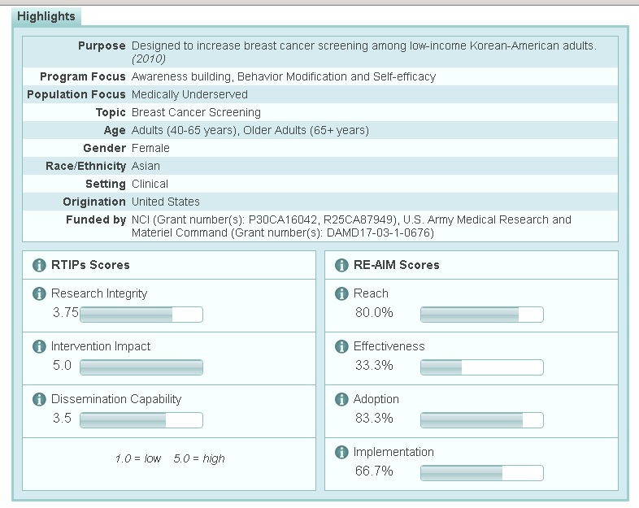
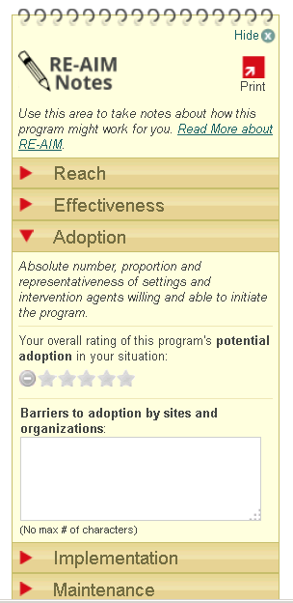
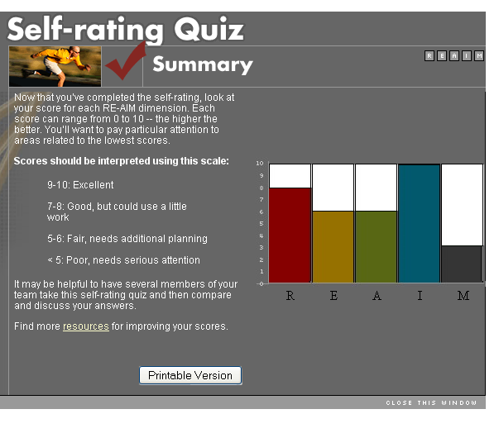
Evidence-Based Program and RE-AIM Resources
http://re-aim.org/resources_and_tools/index.html
http://rtips.cancer.gov/rtips/index.do

Slide 47
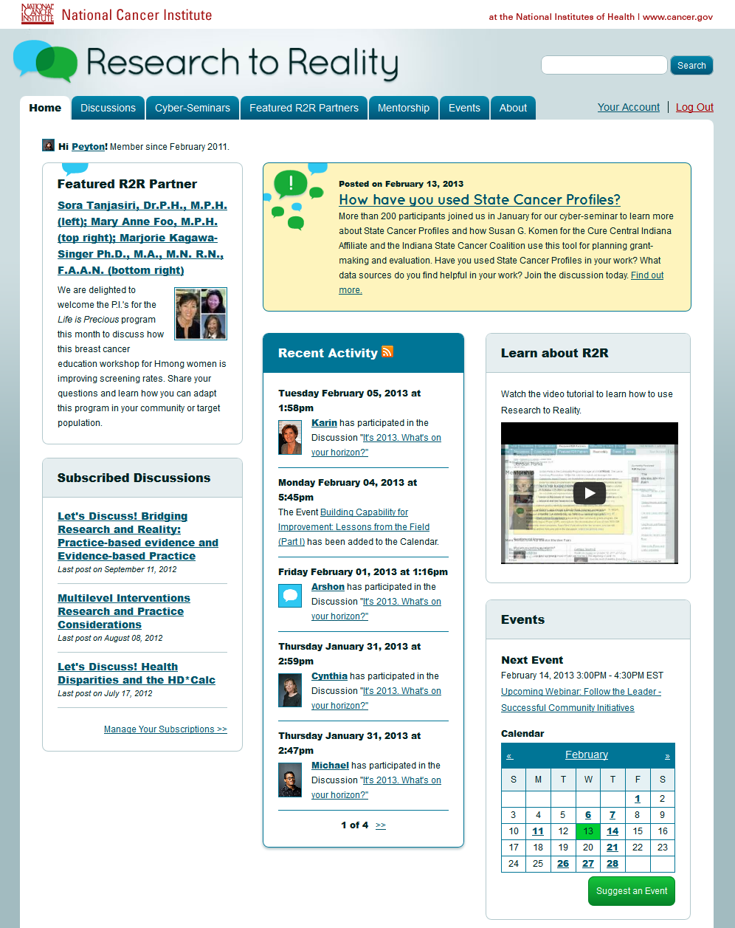
http://researchtoreality.cancer.gov

Slide 48
Online Communities of Practice
March 7th, 2013
R2R Mentorship Close-Out Meeting
Bethesda, MD
Cynthia Vinson, MPA, PhD(C)

Slide 49
Background
National Cancer Institute (NCI) leads national cancer program
Cancer is the 2nd leading cause of death in the U.S
$5 billion annual budget
Very small amount spent on dissemination and implementation (D&I)
It takes an average of 17 years for research to move into practice. (Balas & Boren, 2000)
Programmatic changes, limits on travel & meetings impacting ability for NCI to translate research into practice.
Virtual communities of practice (VCoP) identified as solution.
Notes:
1.6 million will be diagnosed in 2013 and580 thousand will die in 2013
National Cancer Institute (NCI) leads national cancer program
In 2000 the Division of Cancer Control and Population Sciences created a team focused on dissemination and implementation to broaden the focus of NCI’s dissemination efforts from pushing science out to include a focus on developing the capacity of systems to deliver evidence-based interventions and policies as well as working to create a demand for evidence-based approaches. The ultimate goal of these efforts . . .
While NCI is responsible for disseminating research findings it is important to understand that the world is changing. There are limitations on budgets and new and stricter regulations on government sponsored meetings. Technology is also moving forward rapidly.
Until 2010, NCI had field staff that supported dissemination and implementation efforts. Due to several different factors, the program was discontinued which has limited the reach into research and practice for disseminating and implementing cancer control research and has required a reassessment of the type of infrastructure necessary for conducting this type of work.
Without field staff NCI has had to look for other approaches for dissemination and implementation.

Slide 50
Initial Framework
Virtual Communities of Practice to Move Cancer Control Research Into Practice
Domain
Learning Collaborative
Community
Tobacco Control
Public Health Practitioners
Health department
Diet
Survivorship
Genomics
NCI
Researchers
Sun Safety
Screening
Obesity
Clinicians
Advocates
Coalitions
Physical Activity
Policymakers
Practice
Tools
Methods
Meetings
Publications
Websites
Body of Knowledge
Training
Modified from Wenger’s Community of Practice Framework (Wenger, 2004)
Notes:
Domain is a specific area where a COP members are passionate about it and see it as their life work
Community: quality of relationships is important. Leadership by community coordinator and having a core group is important
Practice: focus is to share and develop knowledge
Not just face to face

Slide 51
Primary Research Questions
What do key stakeholders believe is needed to create and sustain federally-sponsored virtual communities of practices aimed at moving cancer control research into practice?

Slide 52
Research sub-questions
How do researchers, practitioners, and intermediaries want to develop and share knowledge in a virtual environment?
What specific topic areas are appropriate for developing virtual communities of practice for moving cancer control research into practice?
Should the communities be topic specific or can a broad community of practice that focuses on all aspects of moving cancer control research into practice be successful (effective)?
Since researchers/practitioners/intermediaries work in silos, should separate communities of practice (COPs) be created for each group or should COPs be designed to include all three groups?
Notes:
Where are patients?
There are many examples of successful on-line COPs focused on patients and lessons learned (Army of Women, Patients Like Me)from these communities will be incorporated in my literature review as appropriate

Slide 53
Literature Review Map
Social Learning Theory
Bandura (1977)
Dissemination and Implementation
Communities of Practice
Virtual Communities of Practice
Rogers (1995)
Haynes & Haines (1998)
Balas & Boren (2000)
Dzewaltowski et. al. (2004)
Singhal and Dearing (2006)
Green et al. (2009)
Glasgow et. al. (2012)
Brownson, Colditz & Proctor (2012)
Orr (1990)
Brown & Duguid (1991)
Wenger (1997)
Wenger (1998)
Snyder, Wenger & de Sousa Briggs (2000)
Wenger (2004)
Conner & Clawson (2004)
Wenger (2009)
Kim (2000)
Andrews, Preece & Turoff (2001)
Lai et al (2006)
Conner & Clawson (2004)
Maloney-Krichmar & Preece (2005)
Iriberri & Leroy (2009)
Millington (2012)
Notes:
Diffusion of innovations focuses on the importance of diffusion networks and how these networks can be effective. Classified in homophilious and heterophilous networks
Communities of practice: come from the social learning theory background and focus on
Chronic Care model- is focused creating a system that utilizes community resources and policies together with improved health system (self management support, delivery system design, decision support and clinical information systems) to improve interactions between informed, activated patients and prepared, proactive practice teams to ultimately improve health outcomes.
Could include Mancur Olson’s The Logic of Collective Action: Public Goods and the Theory of Groups (focusing on how groups are formed and how size of group can dictate if group will be formed at all and the incentives (positive and negative)

Slide 54
Research Approach Concept mapping
Sequential mixed-methods
Qualitative processes
On-line brainstorming, categorizing ideas, rating
Focus prompt:
One issue that should be addressed in order to create successful government-sponsored virtual communities of practice designed to move cancer control research into practice is . . .
Sorting
Rating
Importance for creating virtual communities of practice?
Importance for sustaining virtual communities of practice?
Feasibility for creating and/or sustaining virtual communities of practice?
Interpretation Meeting/Webinar
Federal VCoP Workgroup participated
Provided insight and guidance on cluster names and interpretation of final results.

Slide 55
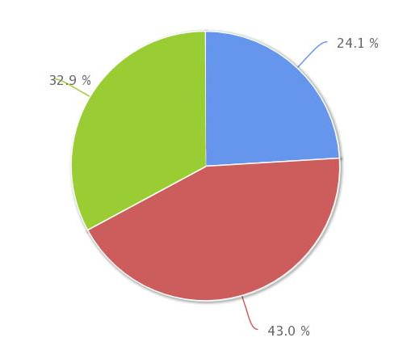
Research Approach (cont.)
Study Sample:
Cancer Control P.L.A.N.E.T (Plan, Link, Act, Network with Evidence-based Tool) web portal (1,300 subscribers primarily practitioners)
Demographics:
Type of organization respondent works for?
Intermediary
Research
Practice
Notes:
Research (academic research/academic teaching)
Practice (community-based education; managed care; private group practice; worksite; etc.)
Intermediary (advocacy; philanthropy/funding; gov’t research/service; state or local gov’t)

Slide 56
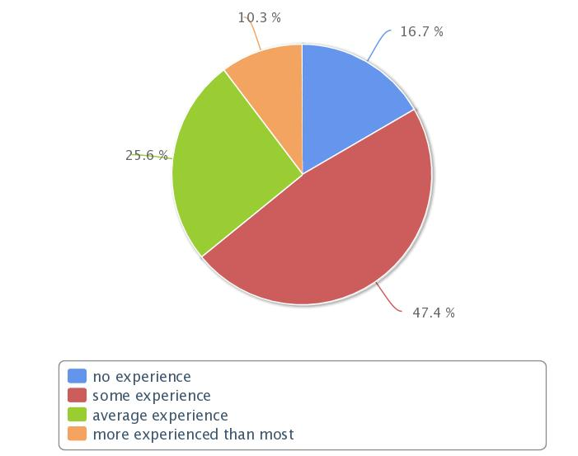
Demographics Cont.
Individual Level of Expertise with VCoP

Slide 57
Response rate
Brainstorming
193 statements originally brainstormed
Duplicates combined (132 statements)
2 categories of statements identified
70 statements related to creating/sustaining gov’t sponsored VCoP
62 statements related to usability and site design
Sorting
78 individuals started sorting/39 completed all sorts (50%)
Rating
66 individuals started first rating
Rating 1=57 completed (86%)
Rating 2= 43 completed (65%)
Rating 3= 40 completed (60%)
Notes:
Usability/site design statements not used in concept map but included in results due to existing literature on the topic
Topics raised by statements:
General Usability
Access
Tools/Resources
Measurement
Subcommittees
Encourage participation

Slide 58
Point Map
26
61
8
37
28
16
14
18
19
36
57
29
5
7
69
64
9
58
66
2
21
45
1
24
31
3
35
50
42
48
62
11
56
33
10
17
47
34
68
15
54
44
51
39
32
6
4
30
40
23
52
25
27
67
43
41
12
59
53
60
49
38
22
55
65
13
46
70
63
20
Notes:
Each point represents one of the statements that has been sorted by the participants. The location on the map matters but the map could be flipped in any direction and the relation between all of the statements would remain the same.

Slide 59
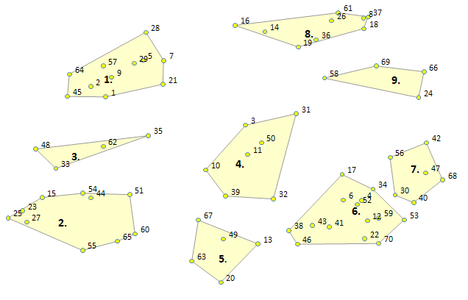
Cluster Point Map

Slide 60
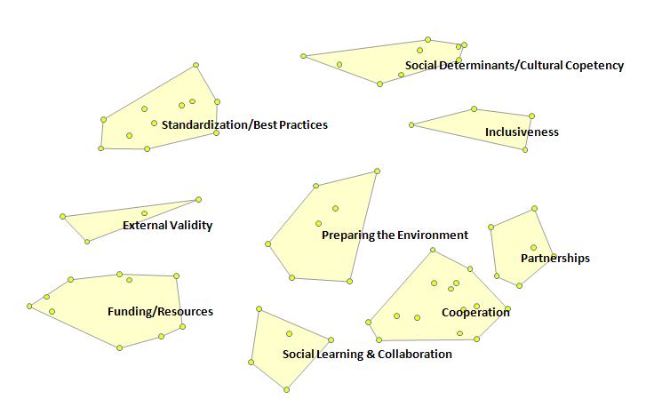
Labeled Cluster map

Slide 61
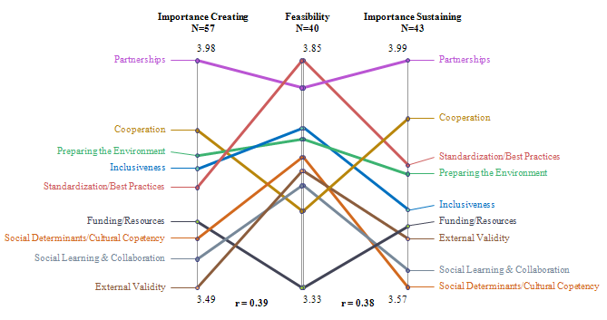
Rating Pattern Match

Slide 62
Pattern Match Importance Creating
Research
N=13
Intermediary
N=17
Practice
N=20
Research
N=13
4.09
3.82
4.08
4.09
Partnerships
Partnerships
Cooperation
Cooperation
Funding/Resources
Funding/Resources
Inclusiveness
Inclusiveness
Standardization/Best Practices
Standardization/Best Practices
Preparing the Environment
Preparing the Environment
Social Learning &
Collaboration
Social Learning &
Collaboration
External Validity
External Validity
Social Determinants/
Cultural Competency
Social Determinants/
Cultural Competency
3.43
r = 0.43
3.40
r = 0.71
3.51
r = 0.83
3.43

Slide 63
Pattern Match Importance Sustaining
Research
N=9
Intermediary
N=14
Practice
N=16
Research
N=9
4.04
3.86
4.23
4.04
Cooperation
Cooperation
Funding/Resources
Funding/Resources
External Validity
External Validity
Partnerships
Partnerships
Preparing the Environment
Preparing the Environment
Standardization/
Best Practices
Standardization/
Best Practices
Social Learning &
Collaboration
Social Learning &
Collaboration
Inclusiveness
Inclusiveness
Social Determinants/
Cultural Competency
Social Determinants/
Cultural Competency
3.47
r = 0.35
3.27
r = 0.24
3.55
r = 0.06
3.47

Slide 64
Pattern Match Feasibility
Research
N=8
Intermediary
N=13
Practice
N=15
Research
N=8
Standardization/
Best Practices
3.99
3.66
3.98
3.99
Standardization/
Best Practices
Preparing the Environment
Preparing the Environment
Partnerships
Social Learning &
Collaboration
Social Learning &
Collaboration
Partnerships
Cooperation
Cooperation
Funding/Resources
Funding/Resources
External Validity
External Validity
Inclusiveness
Inclusiveness
Social Determinants/
Cultural Competency
Social Determinants/
Cultural Competency
3.60
r = -0.22
3.08
r = 0.59
3.31
r = 0.02
3.60

Slide 65
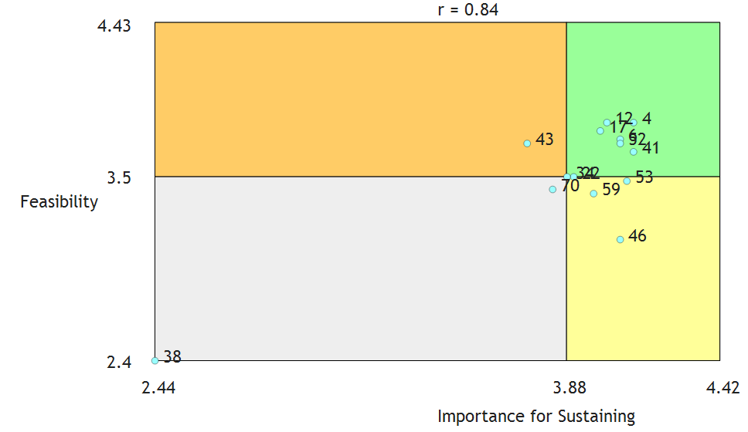
Interagency Cooperation Importance for sustaining
4. working across agencies and disciplines to create useful cancer surveillance tools for cancer incidence and mortality at the finest granularity possible. Partners could include CDC, GIS experts, cancer registries, & cancer advocacy organizations.
6. encouraging a team science or transdisciplinary approach.
12. provide cross-over information from other specialties throughout the chronic disease repertoire.
17. to bridge clinical practices with community-based approaches.
41. participant willingness to share work in progress.
52. devote time and effort into developing partnerships between the research and practice communities. Both communities are susceptible to acting in silos.
43. how to most efficiently and effectively identify topics of mutual interest to the government as well as the CoP participants.
22. the need to bring governmental public health agencies together with private organizations to test ways to implement evidence-based practices.
34. integration with existing virtual communities (many providers are involved in multiple "discussion boards/networks/listservs/blogs/etc") considering how to make this meaningfully interconnected with options that already exist.
46. creation of a norm of open (as opposed to proprietary) sharing among practitioners employed by different and even rival organizations; the normative appeal should be to the field or discipline ("state of the art of the practice") rather than organizational.
38. assuring the linkage between universities that do animal research for cancer with hospitals and medical providers to reduce redundancy in some equipment and laboratory capabilities as well as improving learning from each other.
70. public-private partnerships with health care
53. engage all community organizations (not just gov't) implementing cancer prevention and control efforts.
59. create and maintain collaborative relationships between academic researchers and community leaders outside government to foster research to reality transitions.

Slide 66
Funding
51. develop a repository for practice guidance and allow users to comment on how useful that material was or how they adapted it (e.g., allrecipes.com). 54. centralize and organize all tools and health education materials developed through research grants. 65. to support learning for workers with limited funds for training who are interested in translating research into practice.
4.43
r = 0.66
51
65
54
Feasibility
3.33
55
60
15. creation of mini-grants for CoPs that select and conduct demonstration or implementation projects regarding moving cancer control research into communities or clinical practices. 23. to lower the barriers and red tape in funded projects to allow more freedom in communities to decide where funds should be utilized. 27. to reduce funding barriers to allow for more flexibility of inter disciplinary teams. 60. to ensure sharing of researcher information by making it a requirement of funding.
25. priority funding that can be set aside for participants (particularly practitioners) related to the topic of interest. 44. more transparent community driven grant processes, not grant driven limited data and disparities. 55. making the utilization/participation in a government-sponsored virtual community of practice as a requirement for government funded grants.
44
15
27
25
23
2.4
2.63
3.63
4.33
Importance Creating

Slide 67
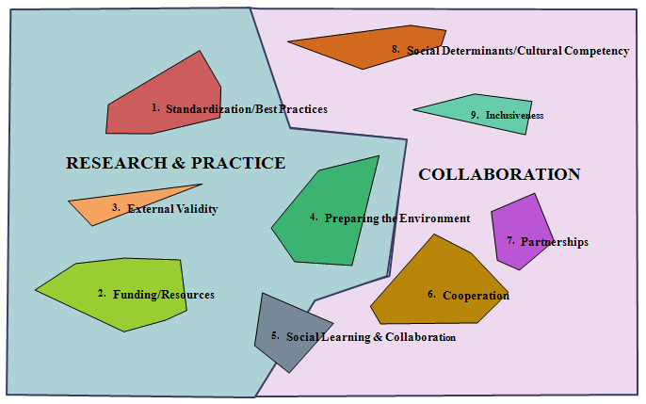
Concept Map Grouped Into Categories

Slide 68
Translating Research into Practice
Collaboration
Modified VCoP Framework
Domain
Learning Collaborative
Community
Tobacco Control
Public Health Practitioners
Health department
Diet
Survivorship
Genomics
NCI
Research
Sun Safety
Screening
Obesity
Advocates
Coalitions
Clinicians
Physical Activity
Policymakers
Practice
Tools
Methods
Meetings
Publications
Websites
Body of Knowledge
Training
Usability/Design
Notes:
In reviewing the concept map, statements that fall under the collaboration side of the map, fit under the dimension of “community” according to this framework. The issues in the collaboration section resonate with Himmelman four-level model of collaboration as well as the characteristics of “mutual engagement,” “joint enterprise” and “shared repertoire” that Wenger describes as an essential component of CoP.
Issues related to usability and design resonates with the “practice” domain. Understanding basic usability principles is important and these principles can be applied to the various tools, resources, websites and trainings developed as part of the practice component of the VCoP. Usability issues that should considered include creating an interface that is intuitive and easy to use, addressing issues of how members access and participate in the community, developing tools that support collaboration and making sure that content on the site is kept current.

Slide 69
Strengths & Limitations
Strengths:
Stakeholder input on how to create/sustain federally-sponsored VCoP.
Equal voice for participants
Researchers, practitioners and intermediaries represented
Limitations:
Relatively small sample size
Reliability
No “correct” answer. Can change over time
External Validity
Only focusing on federally sponsored virtual communities of practice and on cancer control.
Uneven participation among different groups
Notes:
May not be able to generalize findings beyond the groups that were involved in the concept mapping project and the Delphi process or beyond the focus of cancer control
Concept mapping limitations
Response to on-line brainstorming/sorting/rating is voluntary but may not provide a diverse sample of researchers/practitioners/funding agency representatives. Multiple list serves are used to try to achieve the most varied sample.
Delphi process limitations
sample bias- starting out with a small number of individuals that focus on dissemination/implementation and virtual communities of practice may bias the results. To mediate this bias, asking these individuals to identify 1-3 other experts to be interviewed will broaden the input.

Slide 70
Implications for Theory & Practice
Adds to research in the field
Limited research on cancer control dissemination via virtual communities of practice
Extends CoP theory to federal agencies
Recommendations
Expand collaborations and encourage community-engagement
Initially focus on broad issues of translating research into practice. Sub-groups may emerge over time.
Incorporate interactive feedback
Continue to develop funding opportunities for D&I
Continue to engage stakeholders in design of VCoP
Ensure open access and encourage open discussions.

Slide 71
Research To Reality (R2R) Mentorship Pilot Program
March 6-7th, 2013 National Cancer Institute, Bethesda, MD

Slide 72

March 6-7th, 2013 National Cancer Institute, Bethesda, MD

